Slide 1

WaterAPProval
Project presentation
Author:
Laura Schiatti, 904738
Design and Implementation of Mobile Applications (A.Y. 2019/2020) – Politecnico di Milano

Slide 2
ELEVATOR PITCH!
https://youtu.be/kHbYwKZ56fw

Slide 3

Context

Slide 4
WaterAPProval is a mobile application that provides reliable and freely available information on physicochemical characteristics of the water bodies of the city of Cartagena de Indias, Colombia.

Slide 5
Requirements
Map visualization with nodes and water bodies.
Check current nodes information.
Data visualization in different ways: raw and chart
Online ICAMpff calculator
Encyclopedia
Favorites: custom favorite list containing all the nodes of interest for future research
Multi-language feature

Slide 6
Device features
Internationalizing feature: device locale.
Data persistence: SharedPreferences and SQLite database
Gesture detector: allow widgets to detect gesturess
Keyboard type
URL launcher
Fetch data from external services: internet connectivity
Device orientation:
Data visualization widgets: Echarts
Internet Connectivity

Slide 7
Design

Slide 8
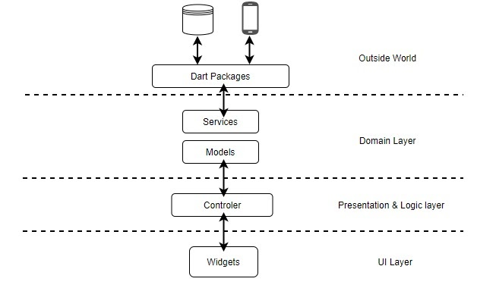
Overview: MVC
Principle of clean architecture:
“The goal is to keep core business logic separate from the UI,
database, network and third-party packages”
Define separate application layers for different areas of concern:
UI, business logic, services

Slide 9



Other design decisions

Slide 10
External web-service APIs

Slide 11



Aquapp API 2.0
Google Maps API (v2)
HTML
CSS
JS
Invemar ICAM web service

Slide 12
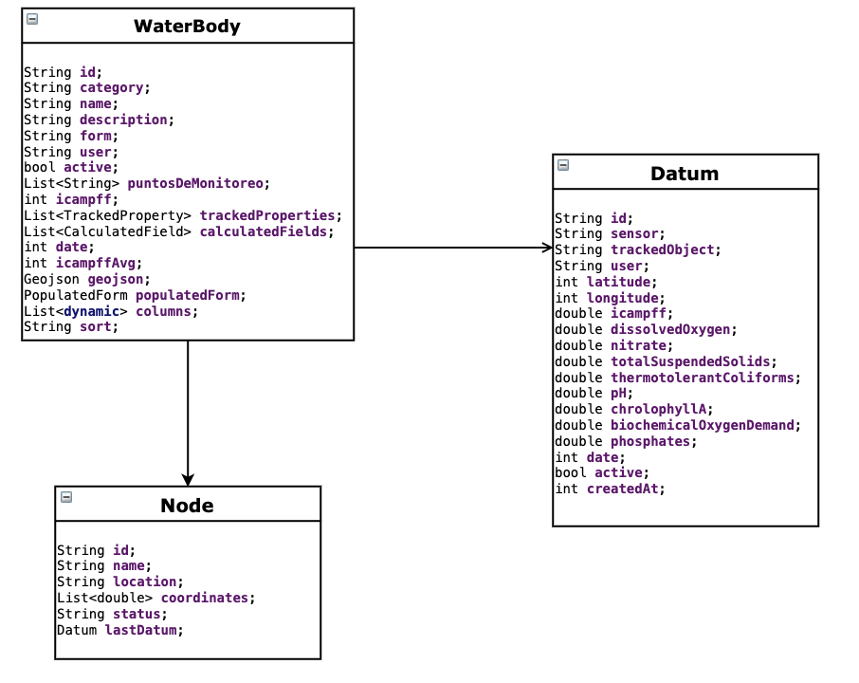
Local Data model

Slide 13
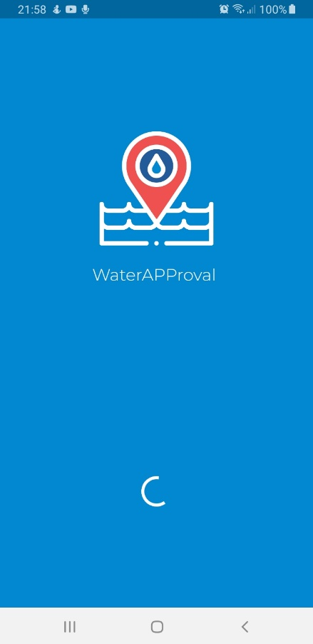
User characteristics
WaterAPProval is freely available for all users, anyone willing to access the application.

Slide 14

User interface

Slide 15
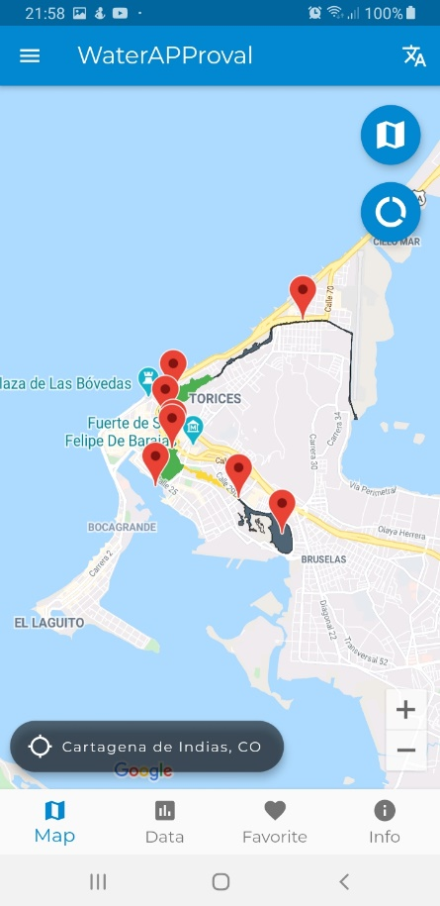
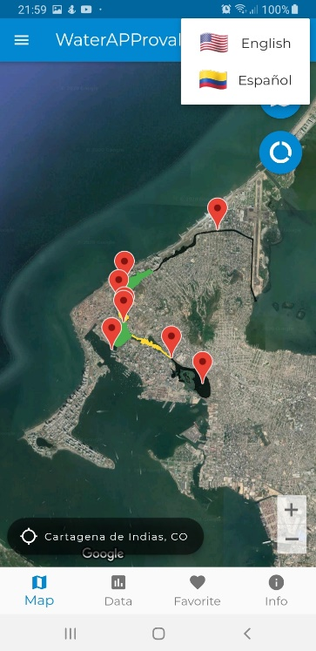
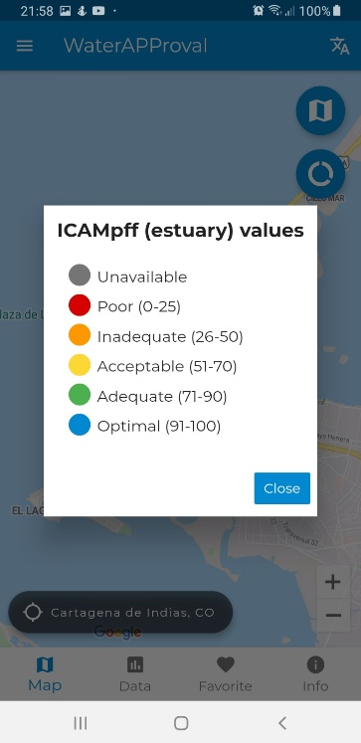
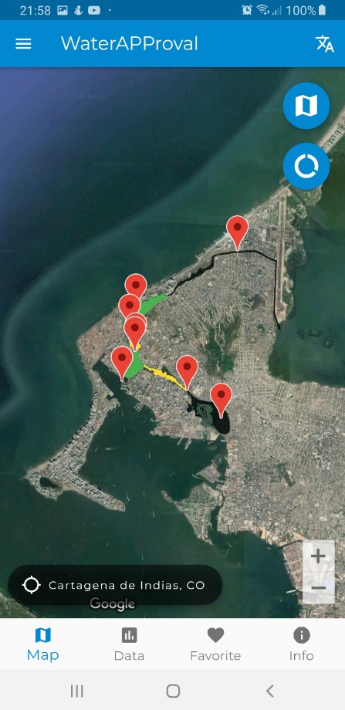
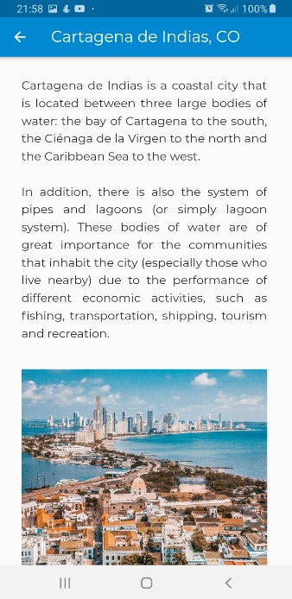
2
3
2
3
1
1

Slide 16
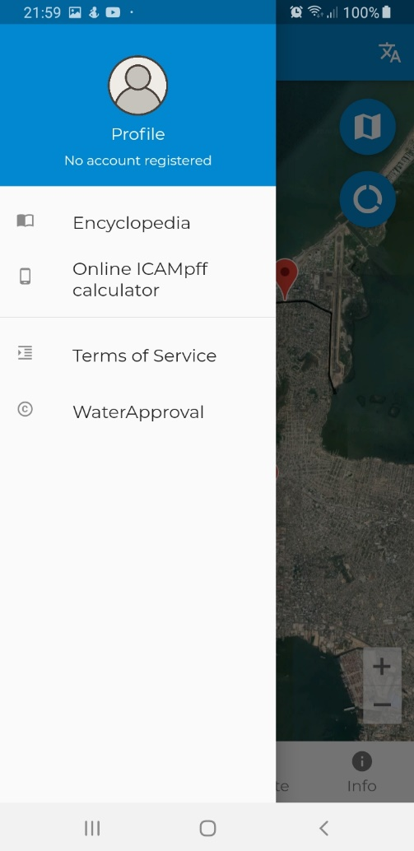
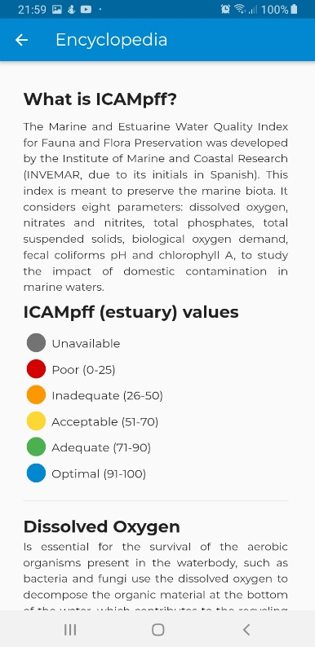
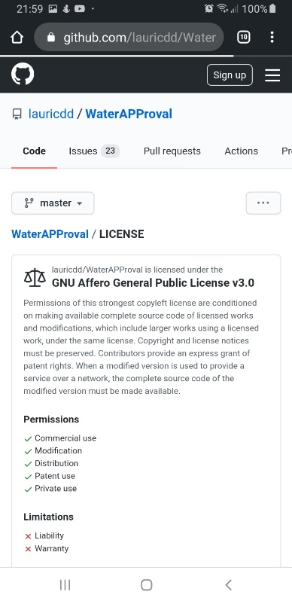
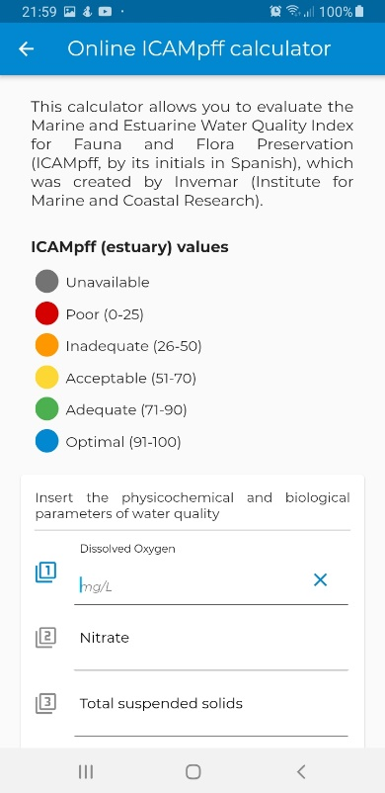
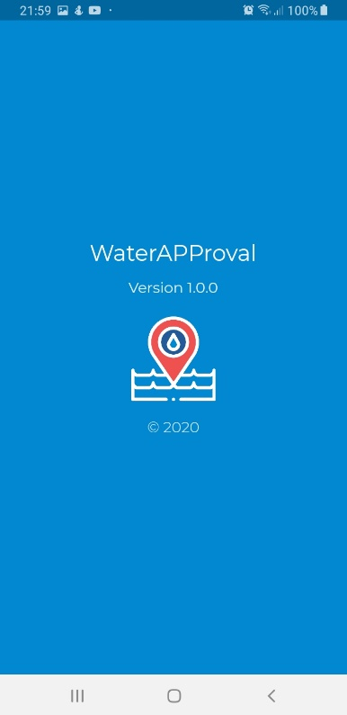
1
3
1
2
3
4
2
4

Slide 17

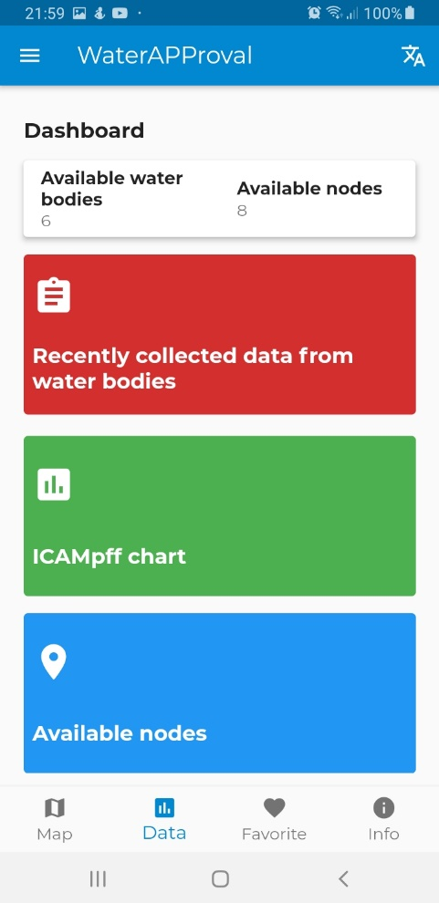
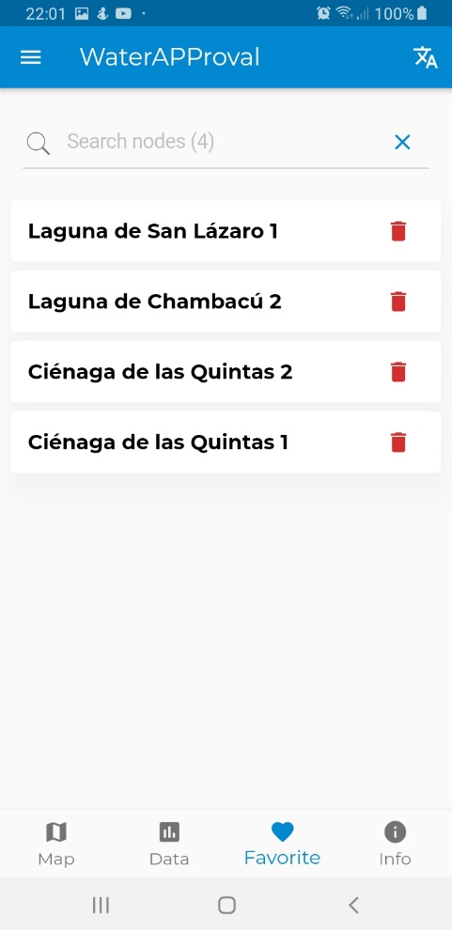
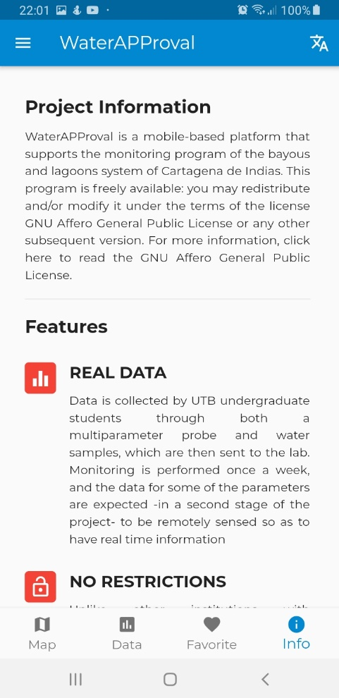
1
2
3
1
2
3

Slide 18

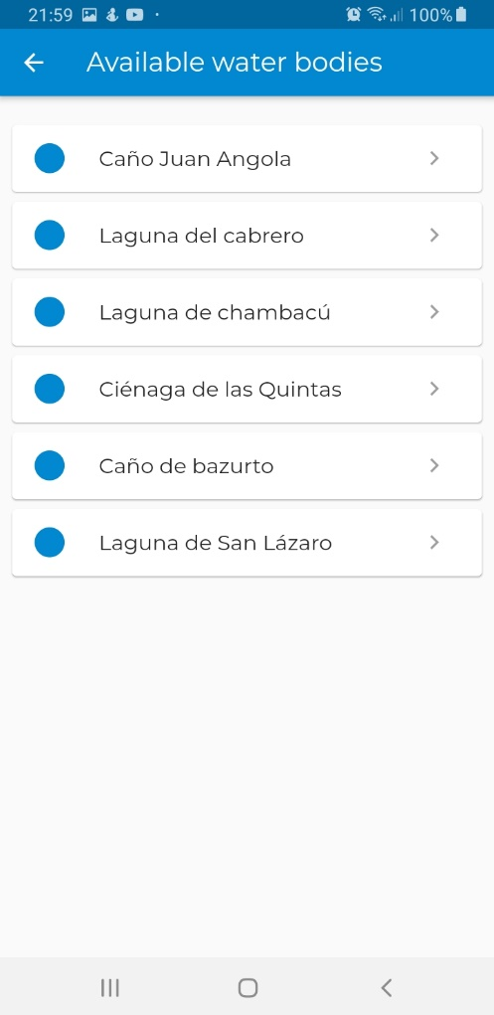
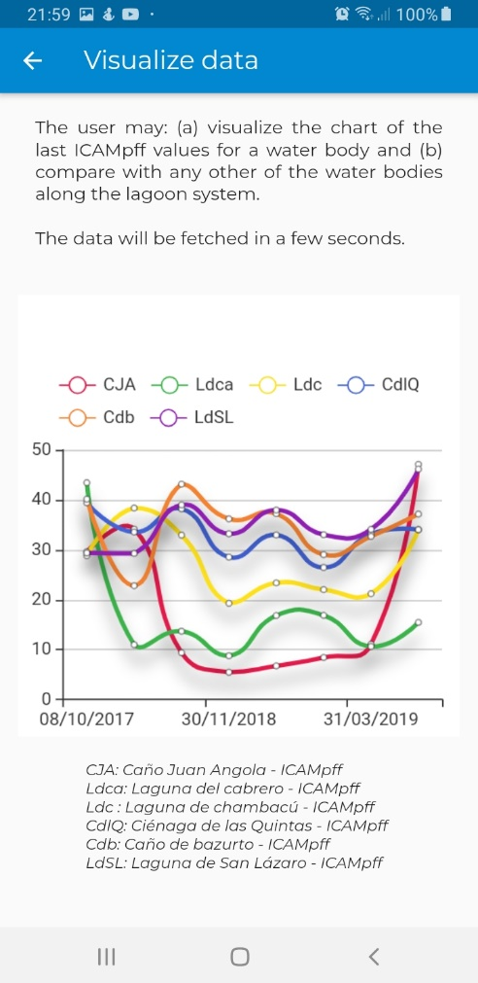
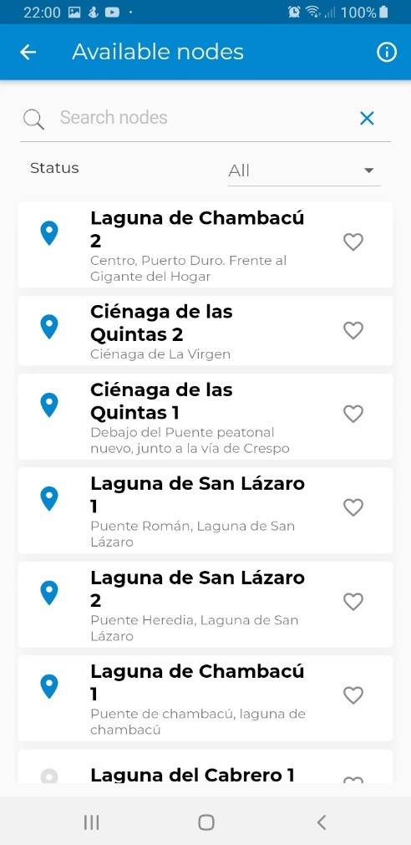
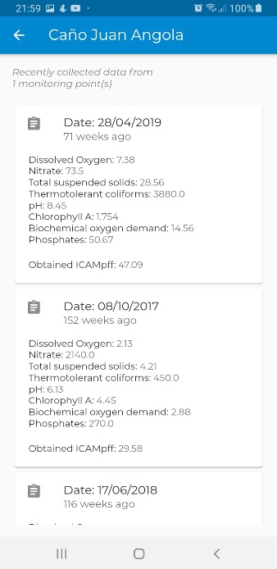
1
1a
1
2
3
2
3
1a

Slide 19
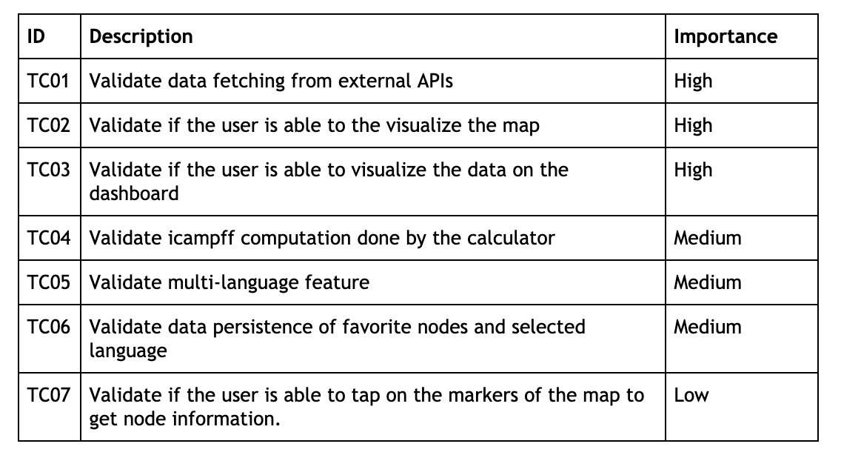
Test plan

Slide 20
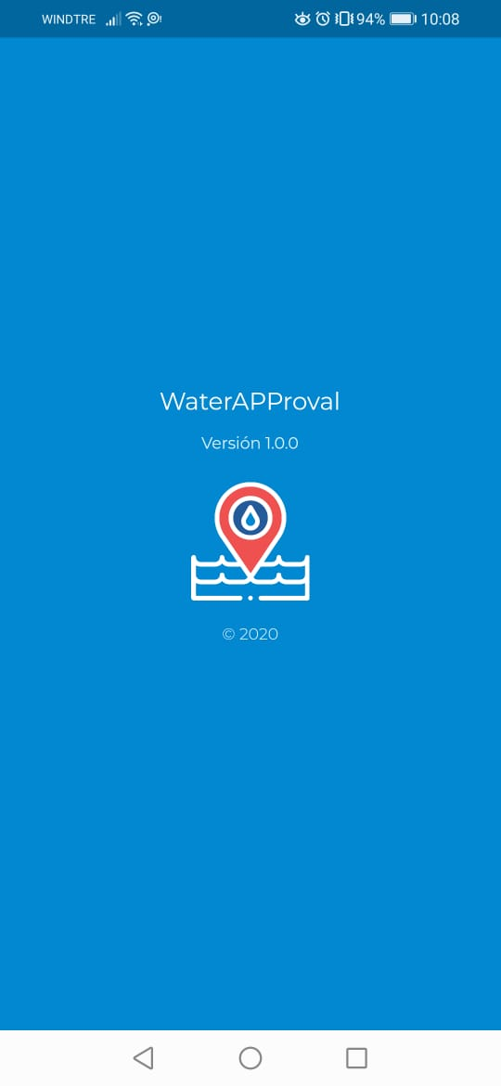
DEMO TIME !

Slide 21

QUESTIONS?

